Slide 1


Meeting June 25, 2024
USG collaboration – open source?
Updated examples, 1D column, 2D hillslope
Simple uniform rectangular element grid generation

Slide 2
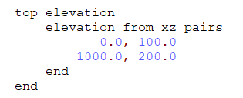
Ground surface elevation from an X,Z pairs list
Ground surface elevation from an X,Z pairs list

Slide 3
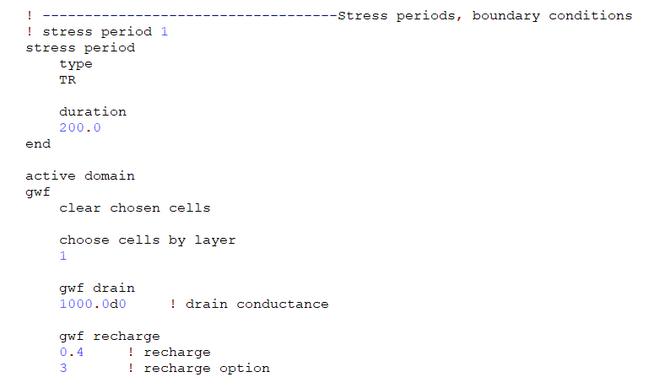
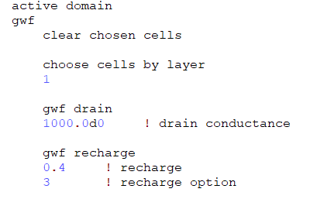
Boundary conditions
Drain: computes drain elevation as top of cell
Recharge: now requires input of recharge option

Slide 4
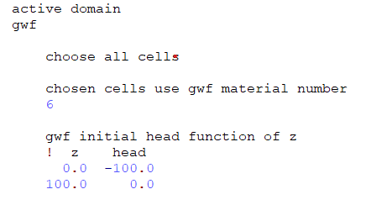
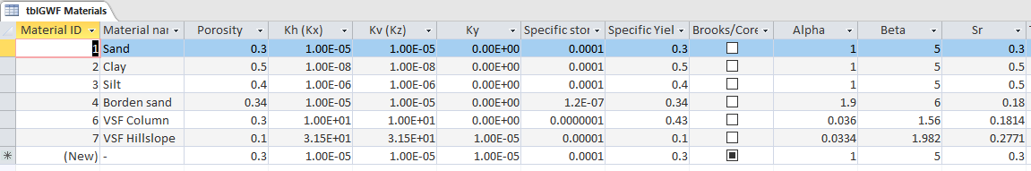
Initial head as a function of z-coordinate and new GWF materials
Below is input to assign Material 6 and define initial head for the to entire 1D column GWF domain

Slide 5
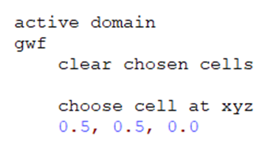
Ground surface elevation from an X,Z pairs list
Ground surface elevation from an X,Z pairs list

